Slide 1

Group 13-Encyclopedia
First Industrial Revolution

Slide 2
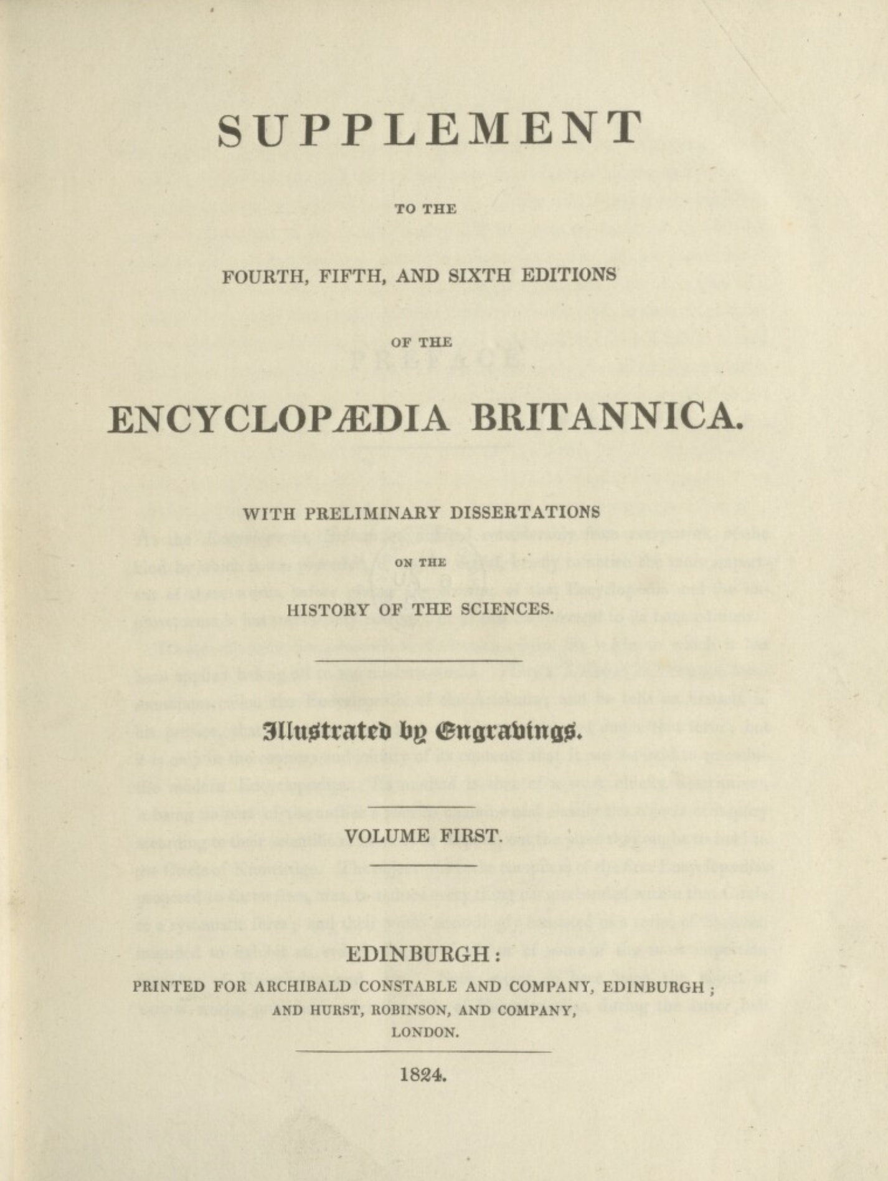
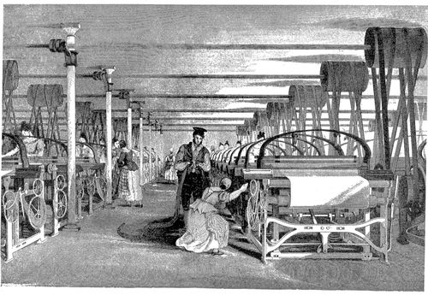
Dataset
1-8 Edition’s txt of Encyclopedia
1768-1860
VR Game

Slide 3
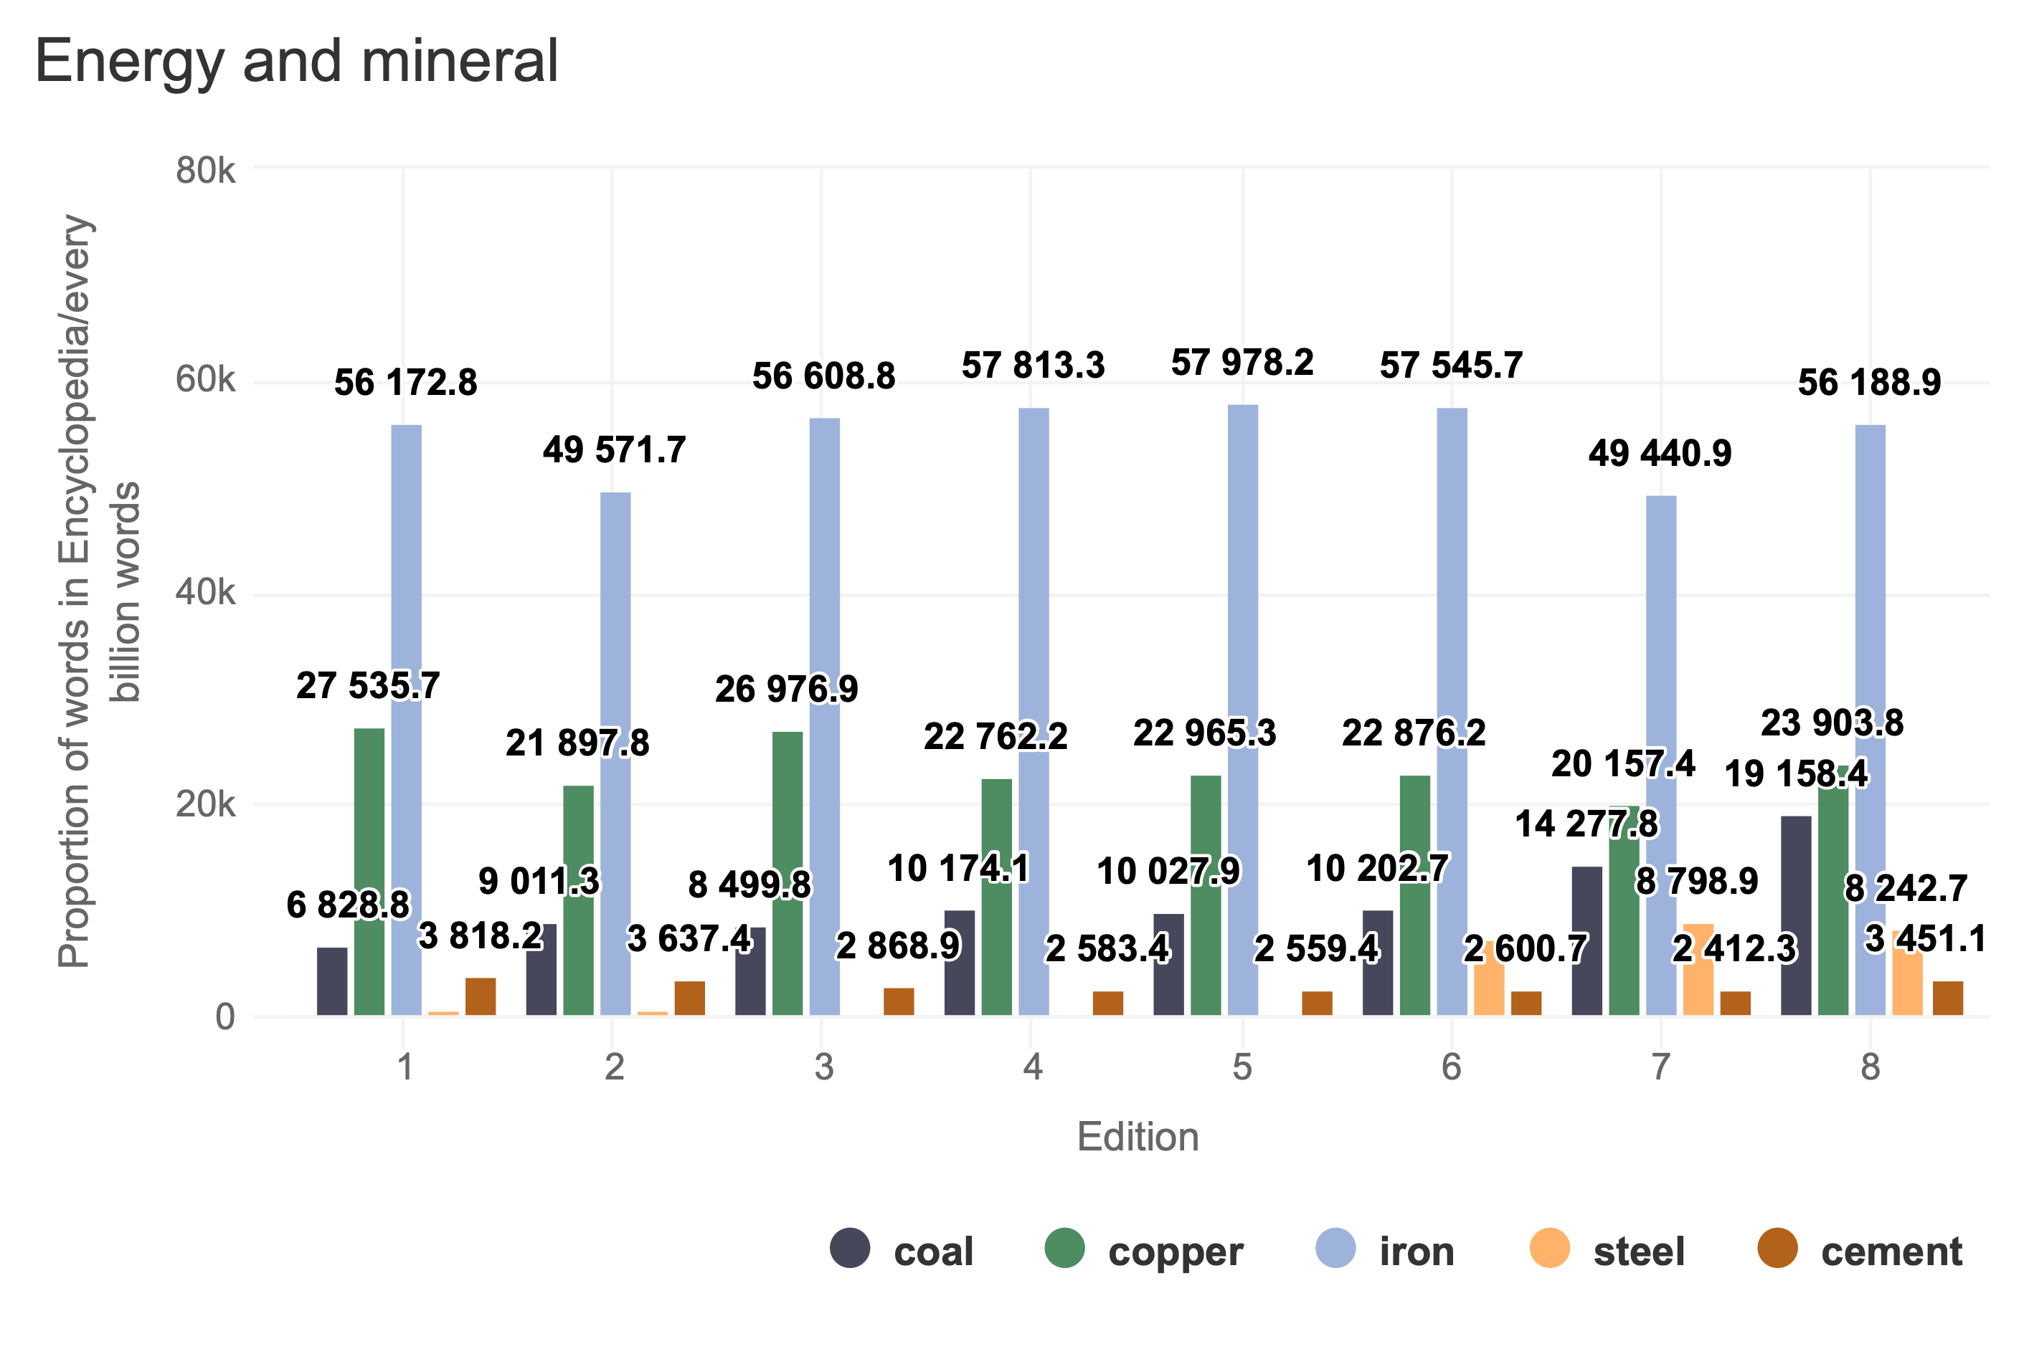

Slide 4
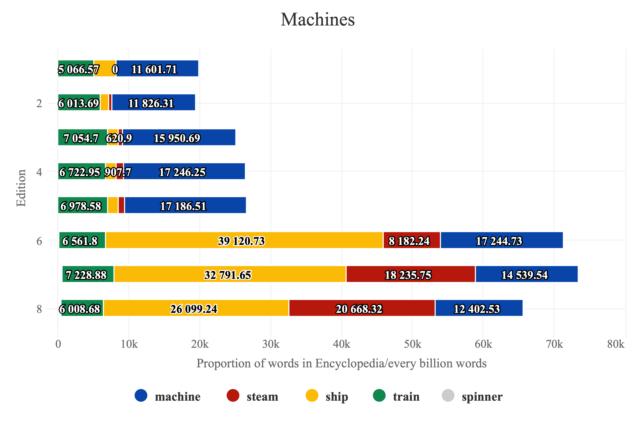

Slide 5
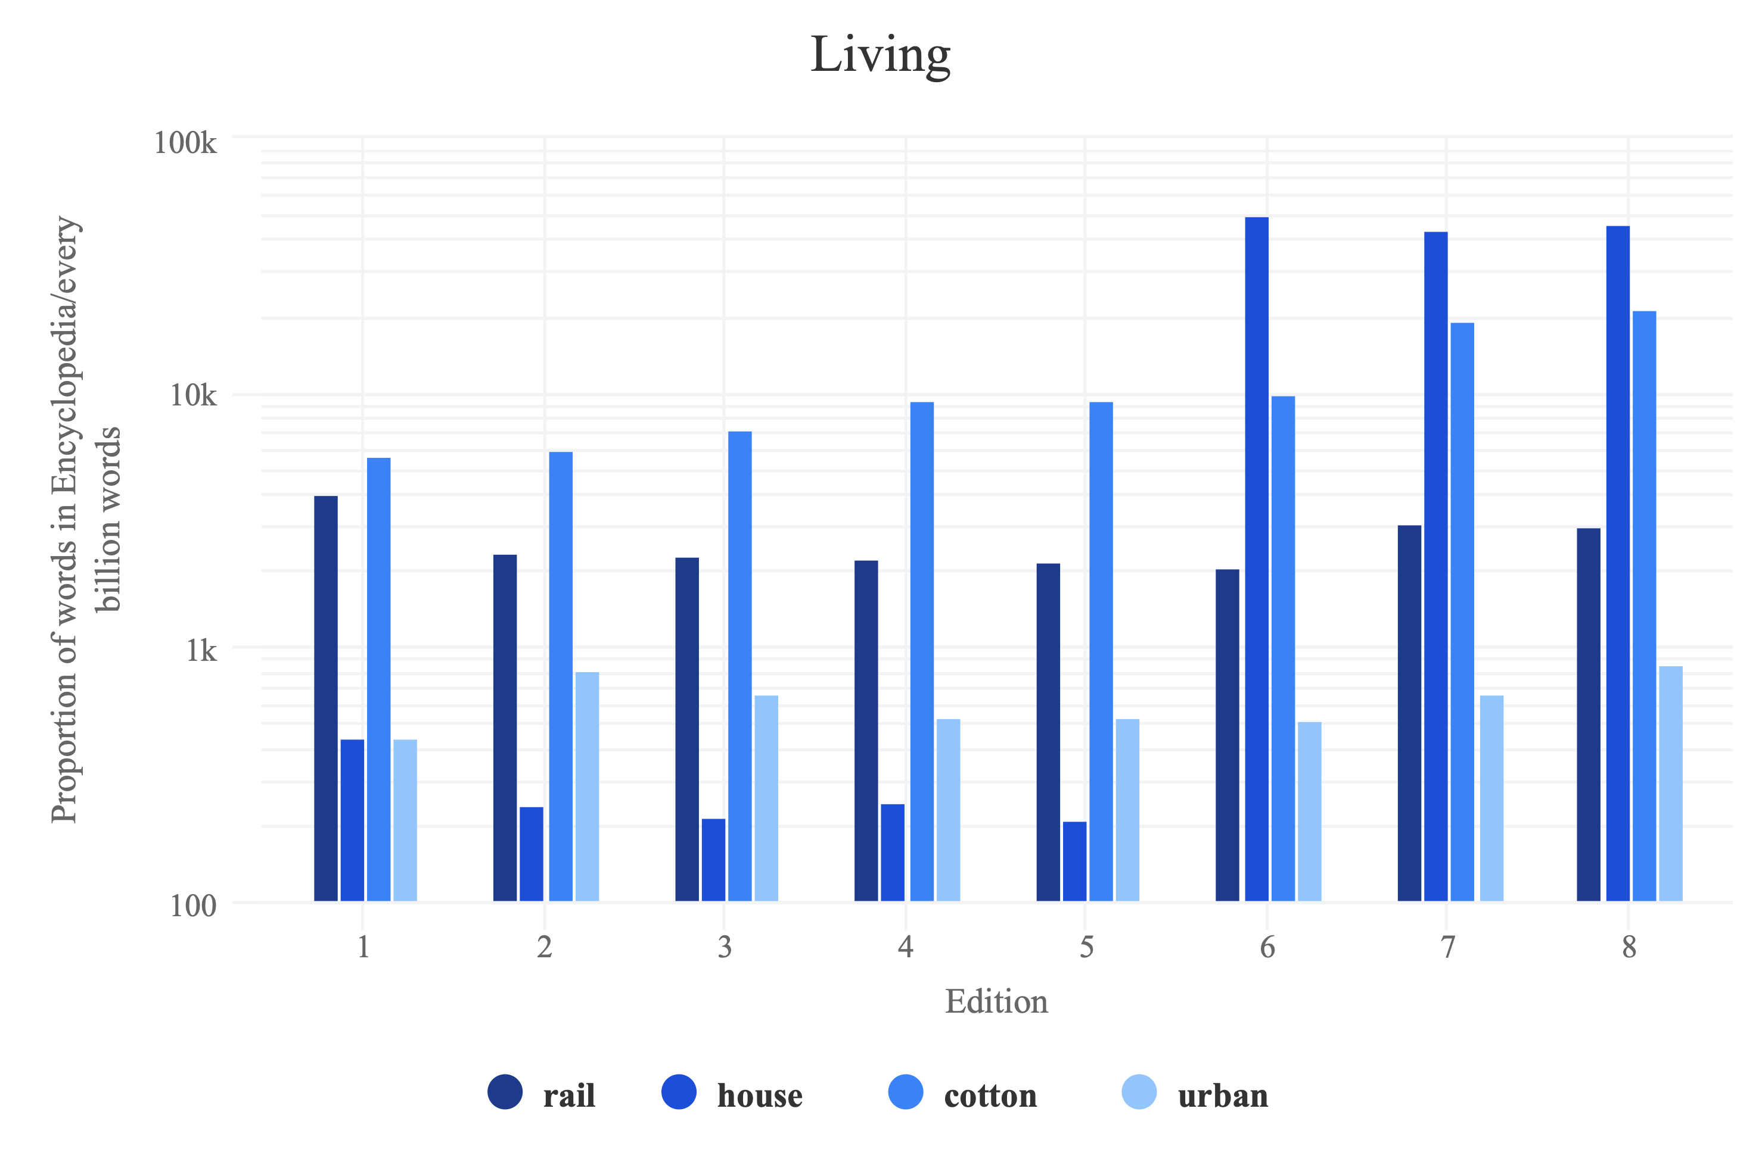

Slide 6
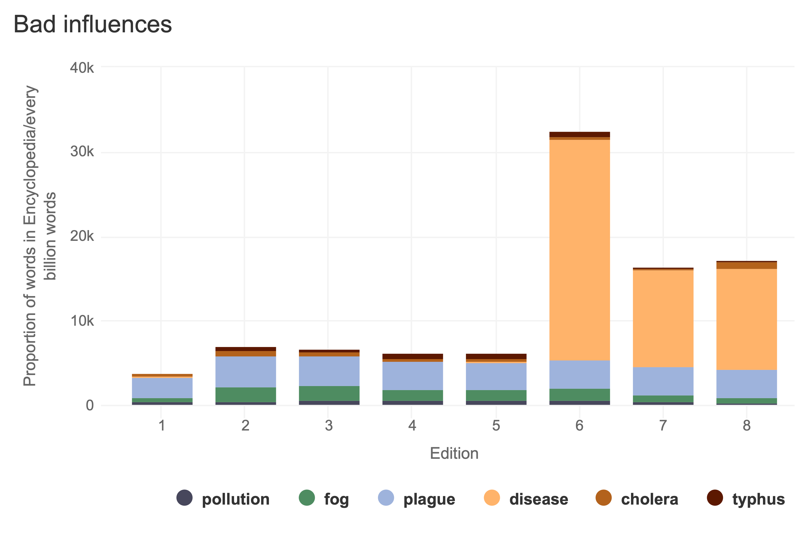

Slide 7

Scenes
VIEW MORE

Slide 8
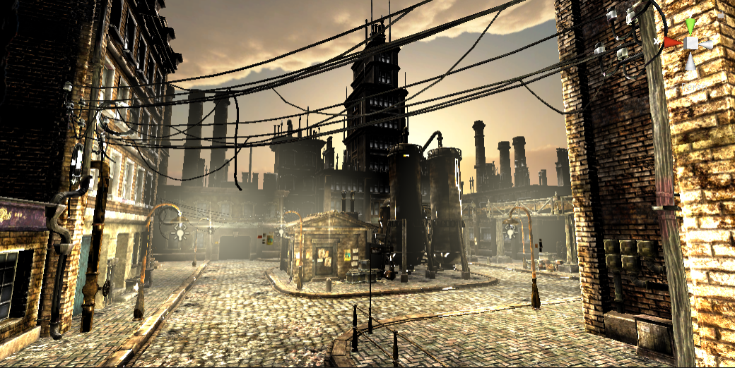
First industrial revolution

Slide 9
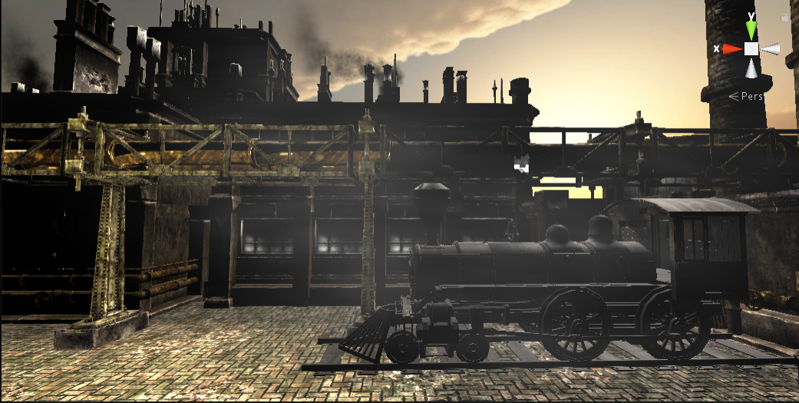

Slide 10
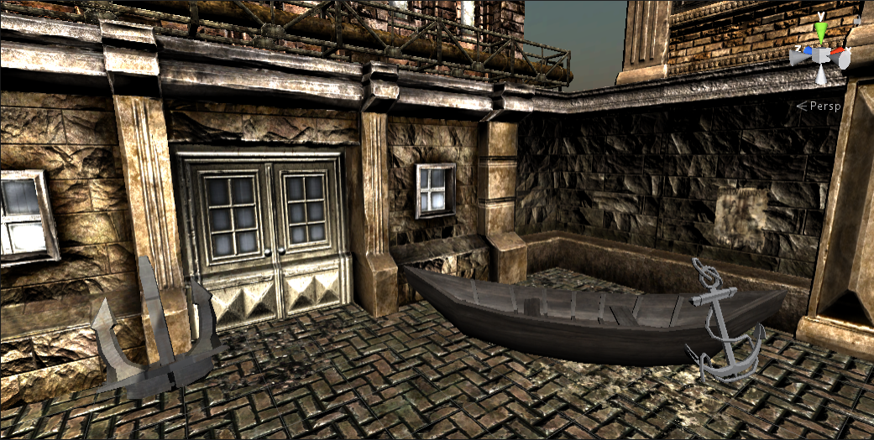

Slide 11
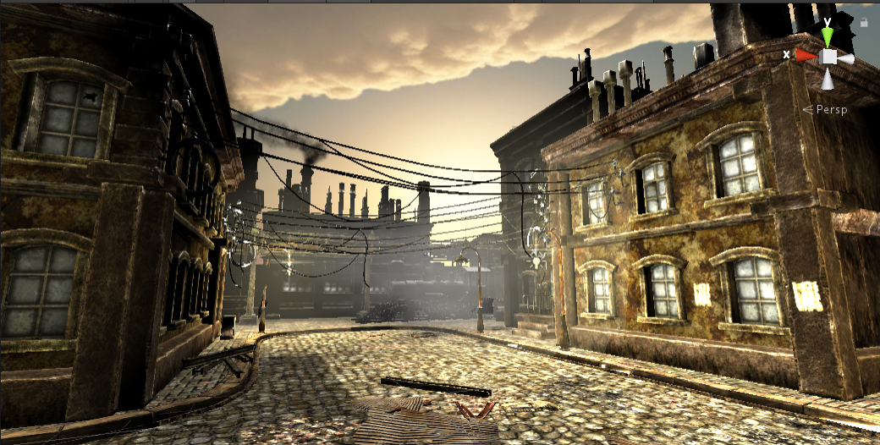

Slide 12

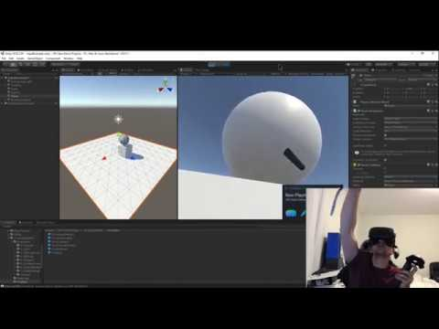
VR Implementation
VR Environment Creation:
The operational scene is built based on an outdoor scene model in Unity Engine, providing the vibes of the first industrial revolution.
VIVE Input Utility – A toolkit that supports HTC / Oculus headsets, used for VR implementation.

Slide 13
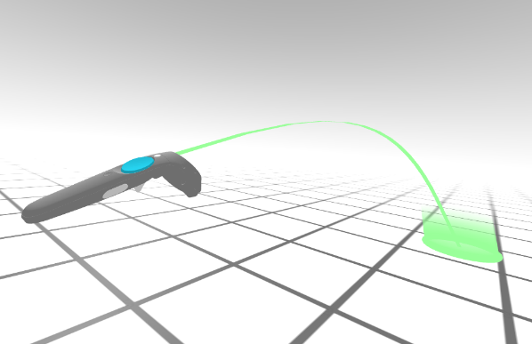
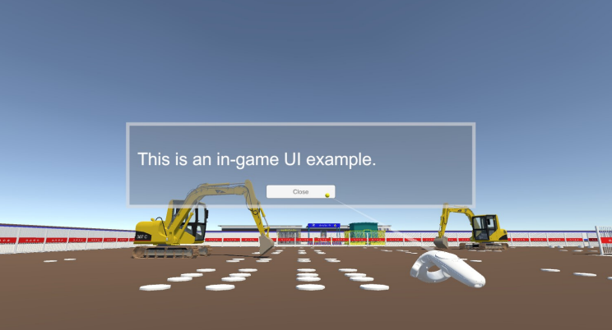
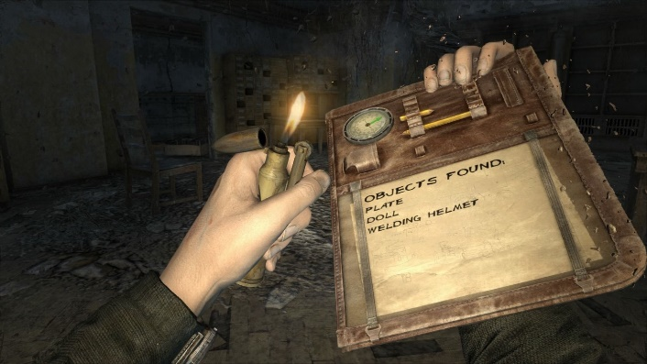
VR Implementation
VR Navigation and Interaction Design:
Teleportation using VR controller: enable the user to explore the virtual sites freely and get instant feedback;
In-game UI panels: hovering in the scene, some follows the player camera, making texts, figures and buttons interactable;
Interaction with in-game objects: user can interact with some in-game objects to further obtain information about our data and the era.

